Slide 1



Chapter 11
Promoting customer service internally and externally
Introduction to customer service
© Hudson & Hudson. Customer Service for Hospitality & Tourism 3rd edn

Slide 2
Topics Covered
Communication strategies
Approaches to service promises
Managing service promises
Ethical issues in communication

Slide 3

‘At Your Service’ Spotlight:
Serving up a dream in Casablanc
Rick’s Café Casablanca is a ritzy restaurant, bar and café located in the city of Casablanca, Morocco.
Designed to recreate the bar made famous by Humphrey Bogart and Ingrid Bergman in the movie classic Casablanca.
Customers don’t necessarily come for the food. “They come for the theme. They come for the dream. It’s a fantasy for some people. It means so much to them to be here.”
Rick’s Café is always looking at ways to improve customer service, and this requires investment

Slide 4
Integrated communication strategies for customer service
The worst mistake a business can make is to over-promise and under-deliver.
Managing communications and expectations
  Integrated marketing communications (IMC)
  Consistent, persuasive message
  Coordinated message and sources of communication
Branding increasingly important
  Create unique identity
  Impart meaning beyond functional roles
Steps for brand building:
  Analysis of market situation
  Development of brand identity
  Communication of brand vision
  Evaluation of brand’s performance

Slide 5
Approaches to service promises
Figure 11.1 (Source: Based on Zeithaml et al, 2007)

Slide 6
Managing service promises
Create effective service advertising
Coordinate external communication
  Unify communications tools, corporate and brand messages
  Consistent, persuasive message to target audiences
Make realistic promises
  Accurately reflect what customers will receive
  Effective internal communication in an organization
Communications tools may include:
  Interactive websites
  International conferences
  Awards and third-party endorsements
  Publicity stunts
  Short, online films
  Reality shows e.g. ‘Can You Serve?’

Slide 7

Managing service promises - continued
Image uses a mixture of both rational appeals (hotel room features), and emotional appeals (skiers enjoying the après ski).

Slide 8

Managing service promises - continued
Use of employees to establish reliability, perceptions of quality

Slide 9
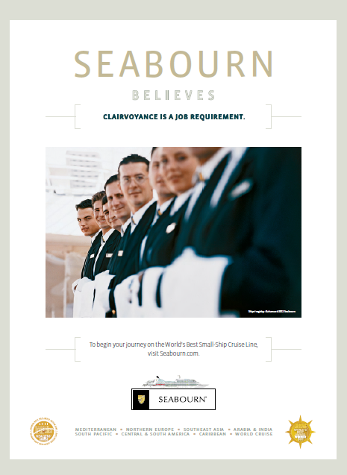
Managing service promises - continued
Employees portrayed as anticipating wants and needs

Slide 10

Managing service promises - continued
Stunts can generate much-needed publicity

Slide 11

Managing service promises - continued
Branded entertainment, short online films

Slide 12
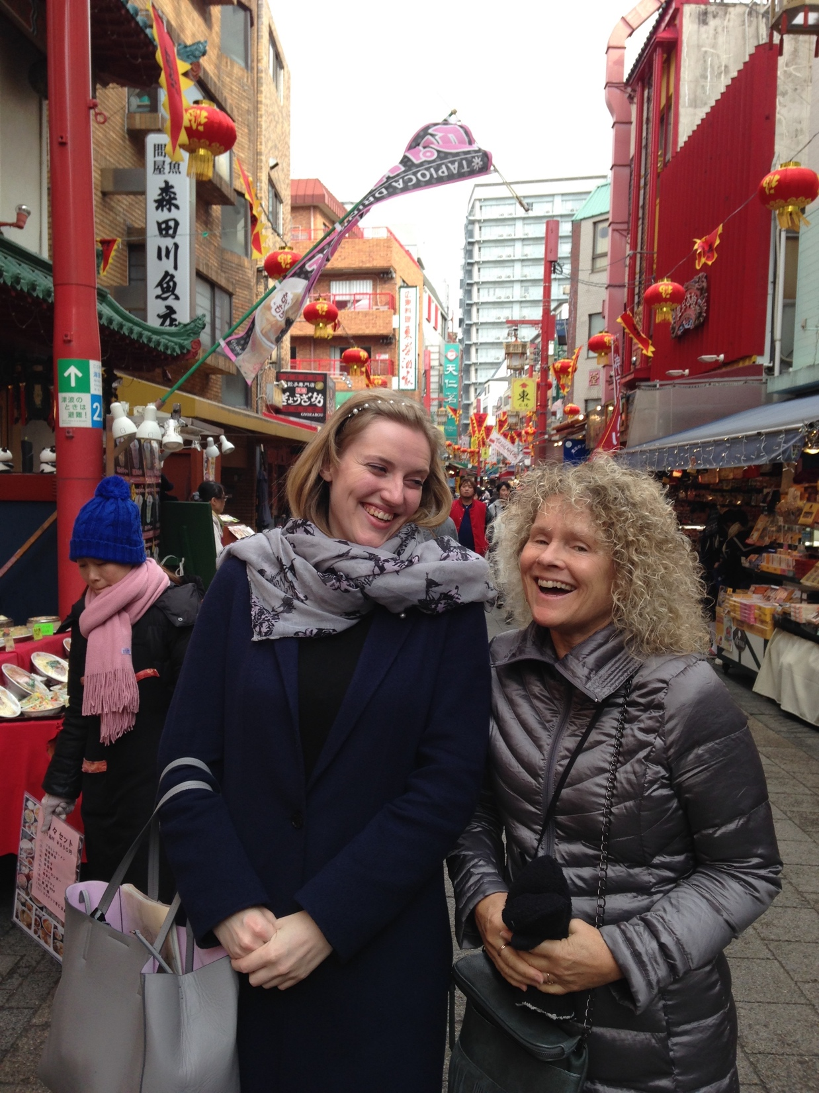
Service Snapshot: Customer service Kobe-style
PR specialist for Kobe City Government
Being able to speak someone's native language enables you to connect with them and understand them on a deeper level
Multi-lingualism, and having experience living and working in other countries and cultures, also offers you a broader perspective on your work from day to day, even if it does not directly involve speaking other languages.
As well as encouraging and entertaining foreign media, she fine-tunes the city’s English homepage and disseminates her love of the area via her own hands-on articles to various newspapers.

Slide 13

Ethical issues in communication
Potential misuse of advertising
Internet descriptions and photos
Product placements not labeled as advertisements
Promoting ethical stance can be good business as it potentially enhances a company’s profits, management effectiveness, public image and employee relations
During the COVID-19 pandemic, hitting the correct ethical tone with communications was critical.

Slide 14
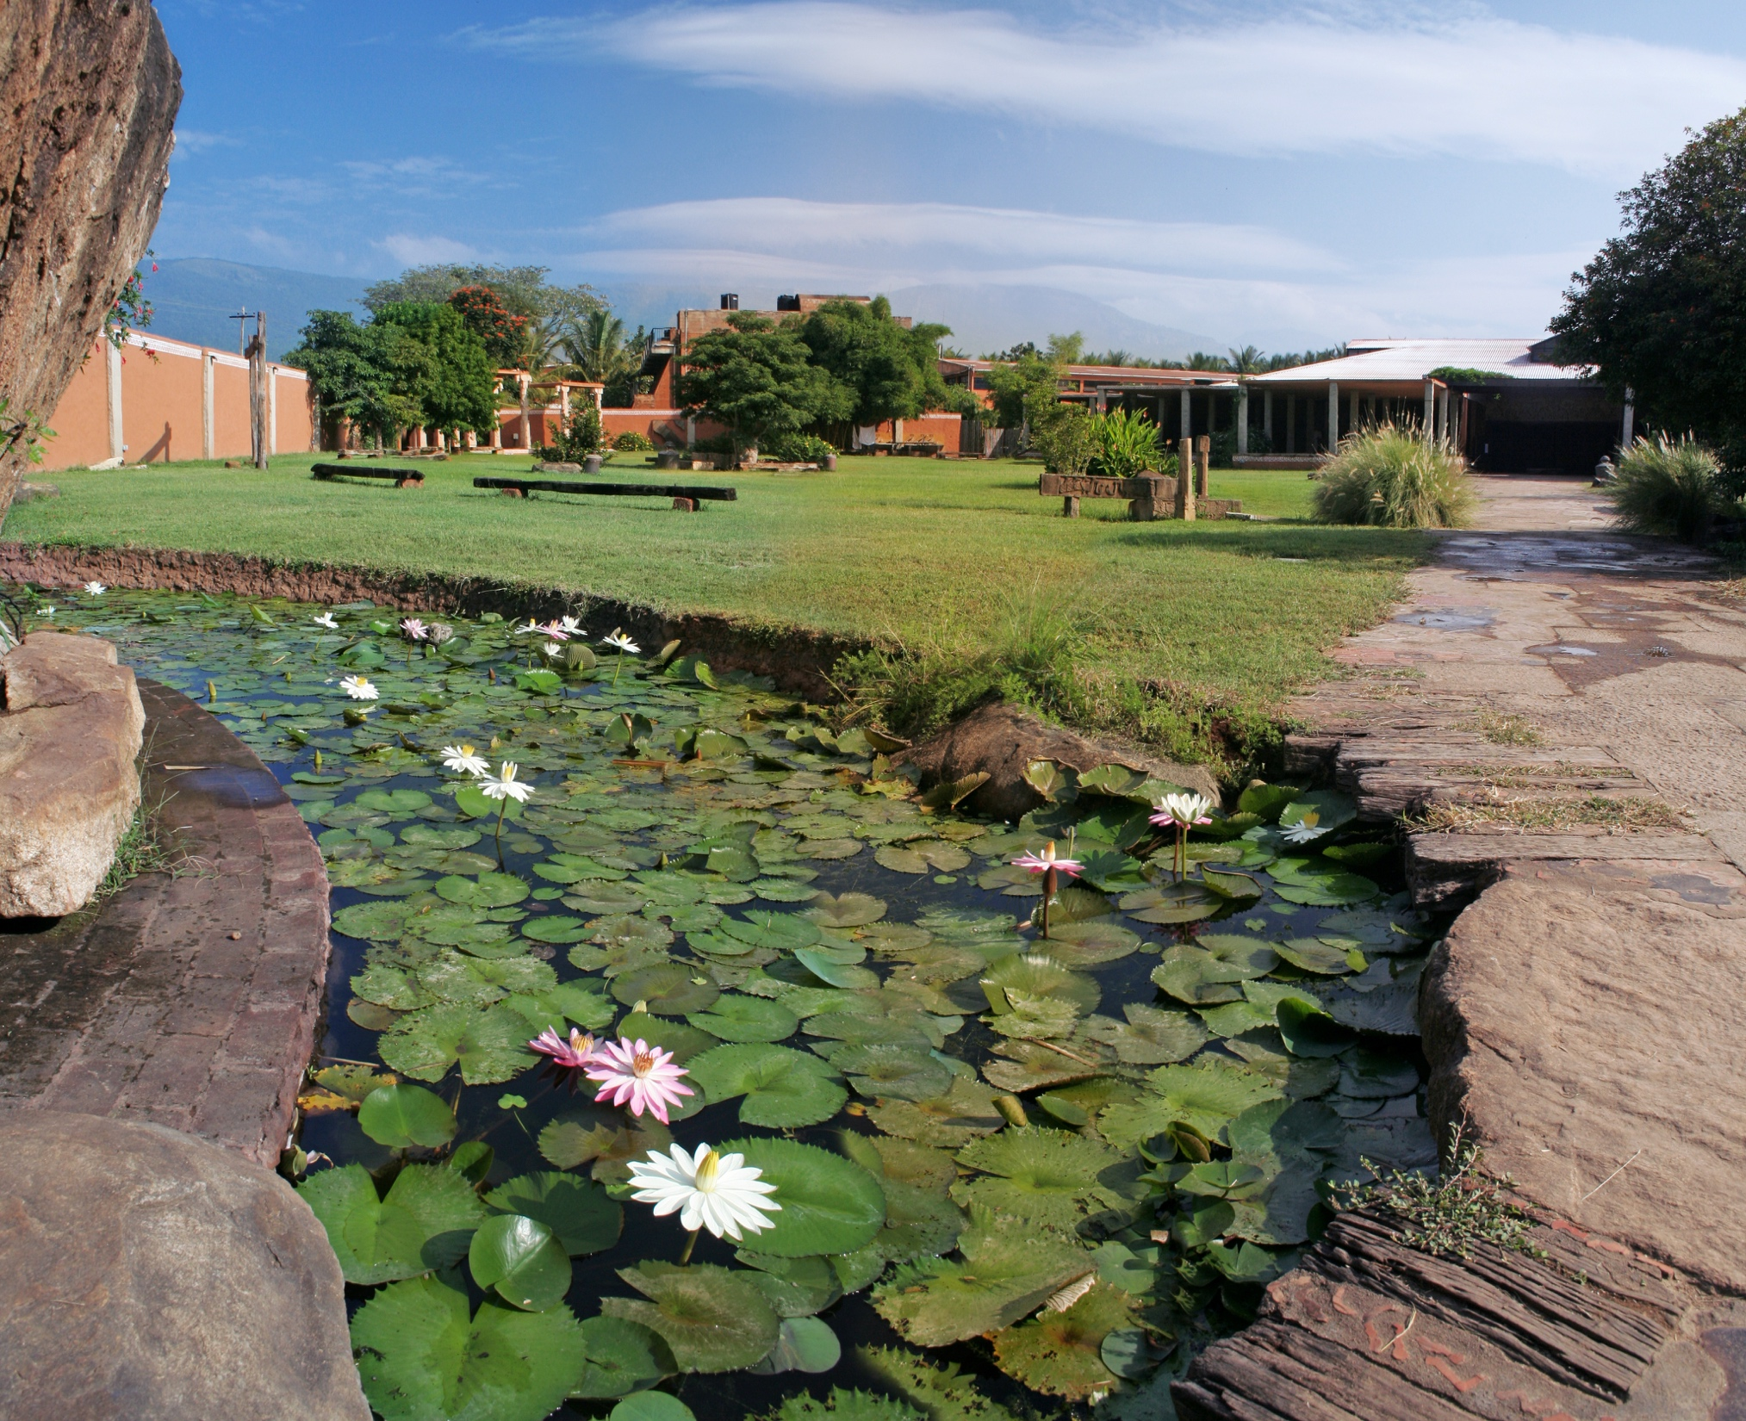
Case Study: Promoting the spirit of India
Isha Yoga Center is the brainchild of Sadhguru
Attracts thousands of visitors from all over the world
Offers all four major paths of yoga
Also the location for major cultural events
Portfolio of product offerings
  Isha Sacred Walks
  Sounds of Isha
  Isha Craft
  Isha Arogya
All promoted via an integrated marketing campaign
During the COVID-19 pandemic, the Isha ashram and its 3,000 volunteers managed to combat the spread of the disease due to self-imposed strict lockdown protocols.

